Slide 1


Multimodal Risk Assessment Application for Parkinson’s disease based On Vocal and Improved Spiral Test
Chan Yi Jie Kelvin A0178430E
Gopa Sen A0178297J
Han Yuen Kwang Andy A0178227X
Lim Pier A0178254X
Teresa Cheng Siew Loon A0178510H

Slide 2
Paper Overview
Proposes framework for multimodal approach for Parkinson’s Risk Assessment
Smart phone application
Uses Multi-modal Input
Vocal recording
Spiral test
Analysis and validation of approach, based on two existing dataset
Proposed structure and flow of application
Conclusion

Slide 3
Parkinson’s Disease
What is Parkinson’s disease (PD)?
Disease of Brain – affects both Body and Mind
Mind -> Cognitive loss including Planning, Decision making, Emotion
Body -> Motor retardation including Speech, Physical Tremors, Stiffness
Future trend -> Increase of Parkinson's disease patients
4.1 million in 2005 to 8.7 million in 2030
Early detection and intervention of PD can slow down disease progression

Slide 4
Overview of background work
PD detection using voice sampling
A. Tsanas, M. A. Little, P. E. McSharry, J. Spielman, and L. O. Ramig, “Novel speech signal processing algorithms for high-accuracy classification of Parkinsons disease,” IEEE Transactions on Biomedical Engineering, vol. 59, no. 5, pp. 1264–1271, 2012
PD detection using spiral drawing
Marta San Luciano; Wang, Cuiling; Ortega, Roberto A; Yu, Qiping; Boschung, Sarah “Digitized Spiral Drawing: A Possible Biomarker for Early Parkinson’s Disease” PLoS One; San Francisco Vol. 11, Iss. 10, (Oct 2016): e0162799.
And many more…

Slide 5
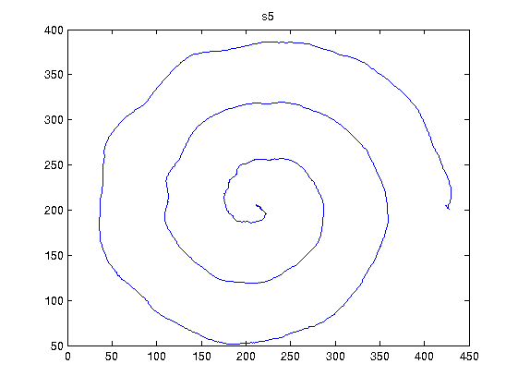
Data Acquisition and Methods
Two data sets from UCI Machine Learning Repository
The Parkinson Speech Dataset with Multiple Types of Sound Recordings
Different types of voice recording samples recorded
Features extracted using acoustic analysis tool
Improved Spiral Test Using Digitized Graphics Tablet for Monitoring Parkinson’s Disease
Patients to trace spiral patterns based on 3 tests
Graphics tablet and digital pen for tracing

Slide 6
Voice Recording-Data and Pre-processing
speech samples from 48 PD patients and 20 healthy individuals
For each of the speech samples collected, 26 acoustic analysis features extracted:
K-Means Clustering to select the Speech Sample
Pairwise Correlation to select acoustic feature to use: final 13 attributes used
Sample No. | Description
1 | Sustained vowel “a”
2 | Sustained vowel “o”
3 | Sustained vowel “u”
4 -13 | Numbers from 1 – 10
14 - 17 | Rhymed Short sentences
18 - 26 | Words
Grouping of Acoustic Features
Jitter (Frequency) | Pulse | Amplitude: Shimmers
Voicing parameters | Pitch parameters | Harmonicity

Slide 7
Voice Recording- Model & Ensemble
3 final models were chosen:
SVM
Random Forest
k-Nearest Neighbours
 | Accuracy | Specificity | Sensitivity
Random Forest | 95.89% | 100% | 91.43%
k-Nearest Neighbours | 83.56% | 87.18% | 79.41%
SVM | 93.15% | 100% | 86.49%
Ensemble (using majority voting) | 95.89% | 100% | 91.43%

Slide 8
Spiral Image- Data and Pre-processing
15 healthy individuals (control set) and 62 with Parkinson’s disease (PWP)
3 types of handwriting samples
Pearson’s Correlation: Z and Pressure have high correlation
Pressure has more information
Z to be removed
Grip angle is removed for app viability
Test | Description
Static Spiral Test | Tracing of a Spiral Drawing
Dynamic Spiral Test | Tracing of a Spiral Drawing, Spiral appears intermittently
Stability Test on Certain Point | Hold the stylus and on a point on screen without hand touching
Parameters
X | X position (left/right) of the screen
Y | Y position (up/down) of the screen
Z | Z position of the pen (perpendicular to the screen)
Pressure | Pressure on the screen with the digital pen
Grip Angle | Individual user grip angle of the pen
Notes:
Static spiral test (SST) - determines motor performance and tremor
Dynamic spiral test (DST) – spiral disappears and appears in certain time intervals, forcing patient to keep pattern in mind and continue to draw
Stability Test on Certain Point (STCP) - hold digital pen on the point without touching screen. Determine hand stability or hand tremor level.

Slide 9
Spiral Image- Model & Ensemble
For each test, multiple models were evaluated
Best model for each test was chosen using the below techniques:
Logistic Regression
k-Nearest Neighbours
Adaptive Boosting
 | Accuracy | Specificity | Sensitivity
Logistic Regression (Static Test) | 98.8% | 94.6% | 96.1%
K-Nearest Neighbours (Dynamic Test) | 99.6% | 99.6% | 99.6%
Adaptive Boosting (Stability test) | 94.99% | 86.9% | 99.9%

Slide 10
Evaluation Results
Analysis shows that both methods are suitable for early PD detection
Proposed: If either vocal or spiral tests are positive, we diagnose it as PD
Vocal Tests
PD Risk
Evaluation: PD Risk
Spiral Tests
No PD Risk

Slide 11

Proposed Application – Input Trained Models
Trained Models
Data

Slide 12
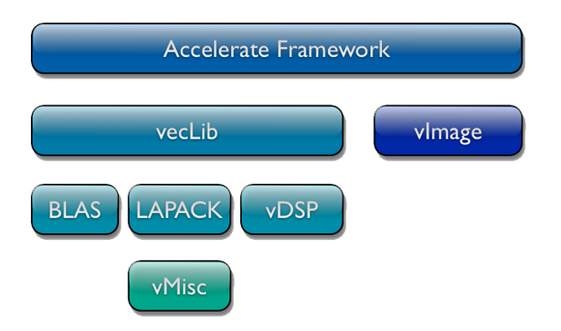
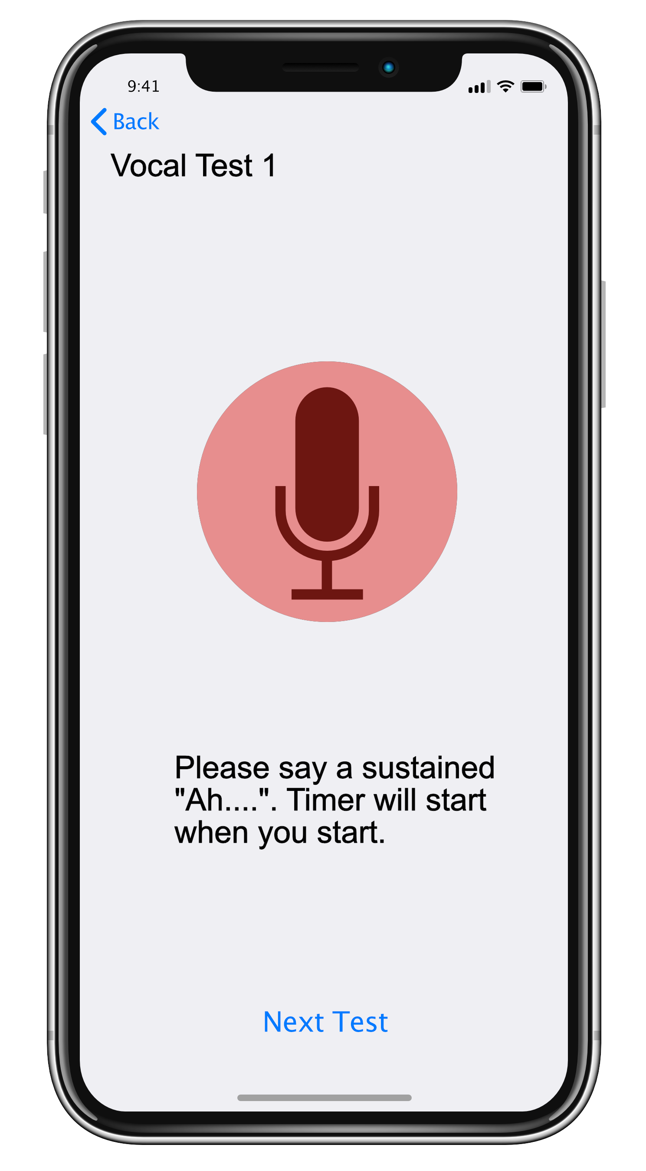
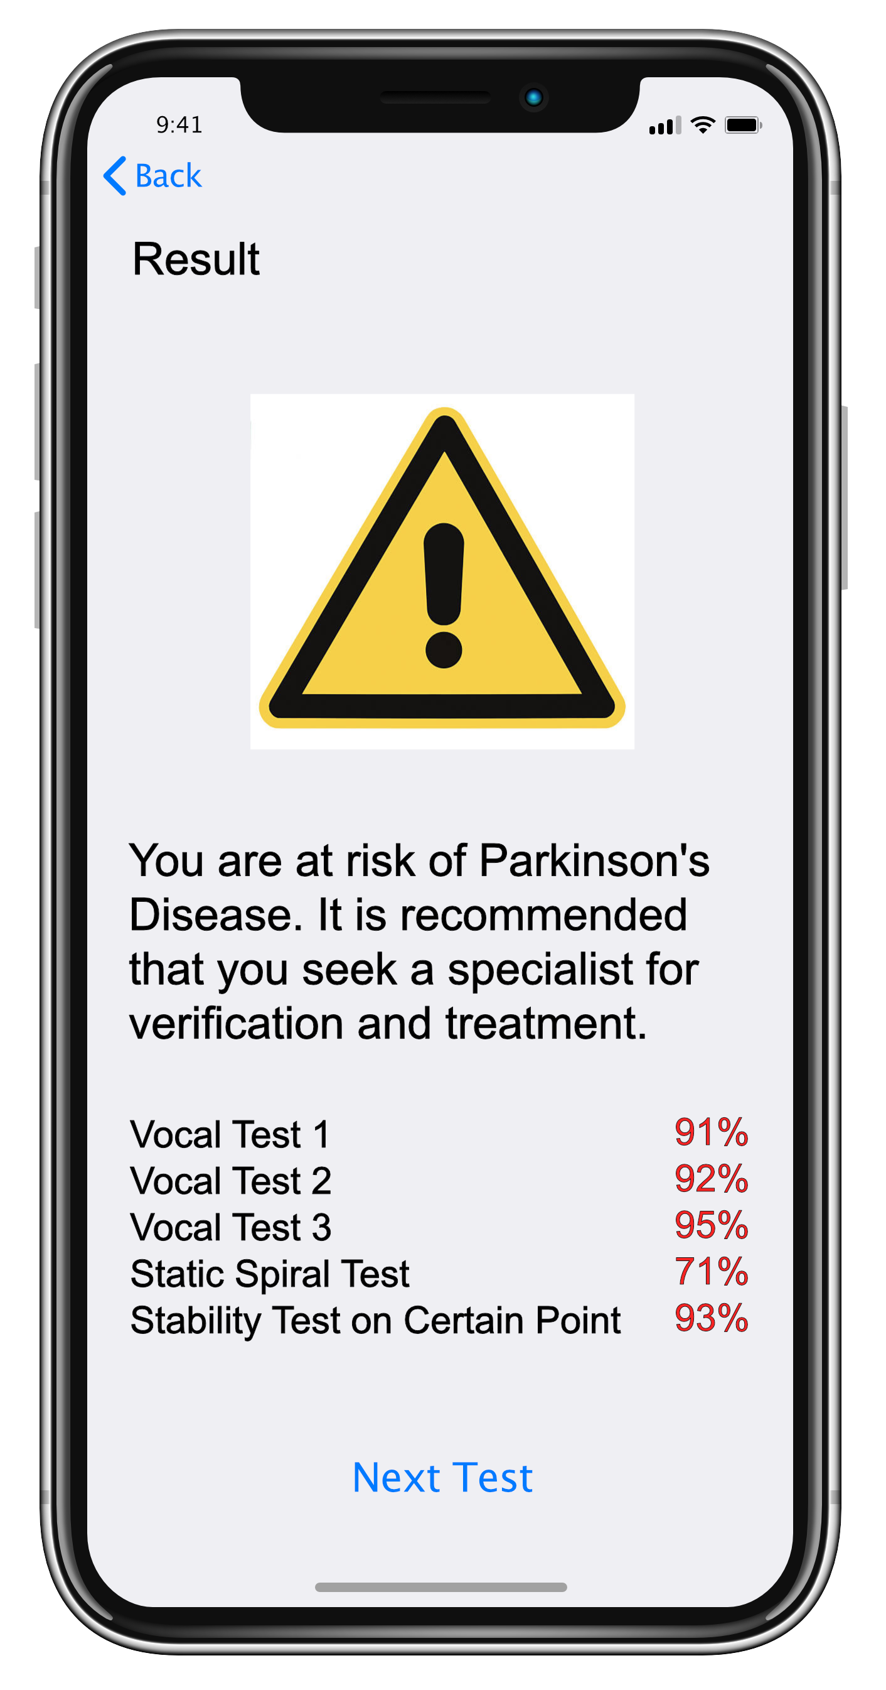
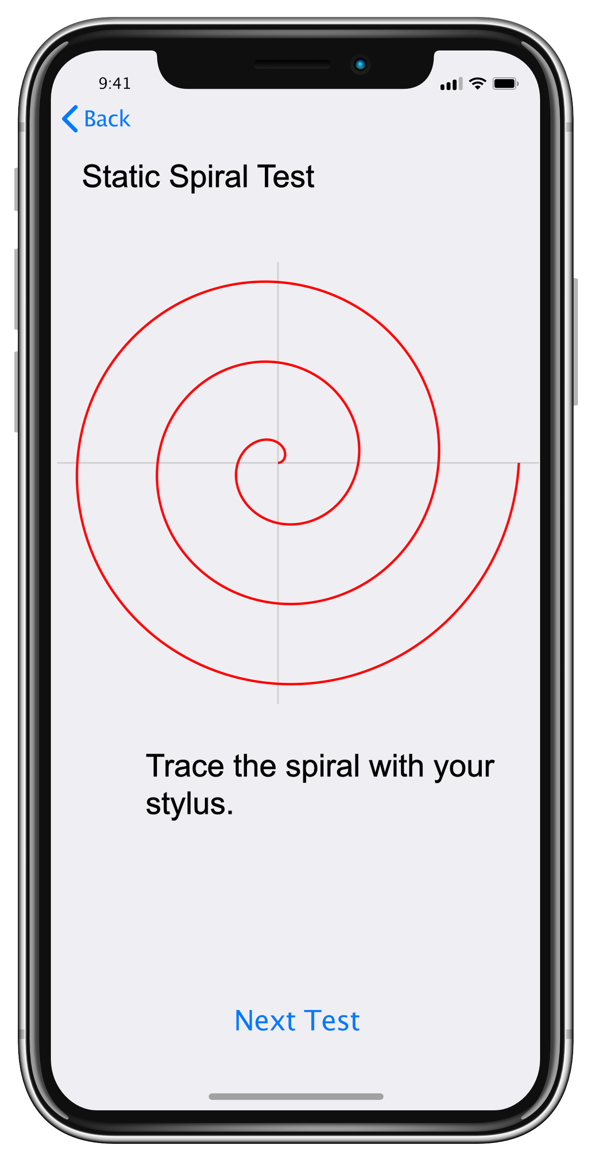
Operation Flow
Processed Vocal Attributes
Inference
Vocal Result
Diagnosis
Inference
Spiral Test Result

Slide 13
Conclusion
Early detection of PD critical
Early symptoms of Parkinson’s different for every patient
Speech and spiral test for early PD detection
Two pronged approach
Substantiates the app proposal
Due to limited data, more data to be collected with the app itself
Geographical Bias (University of Istanbul)

Slide 14
Q & A

